Slide 1
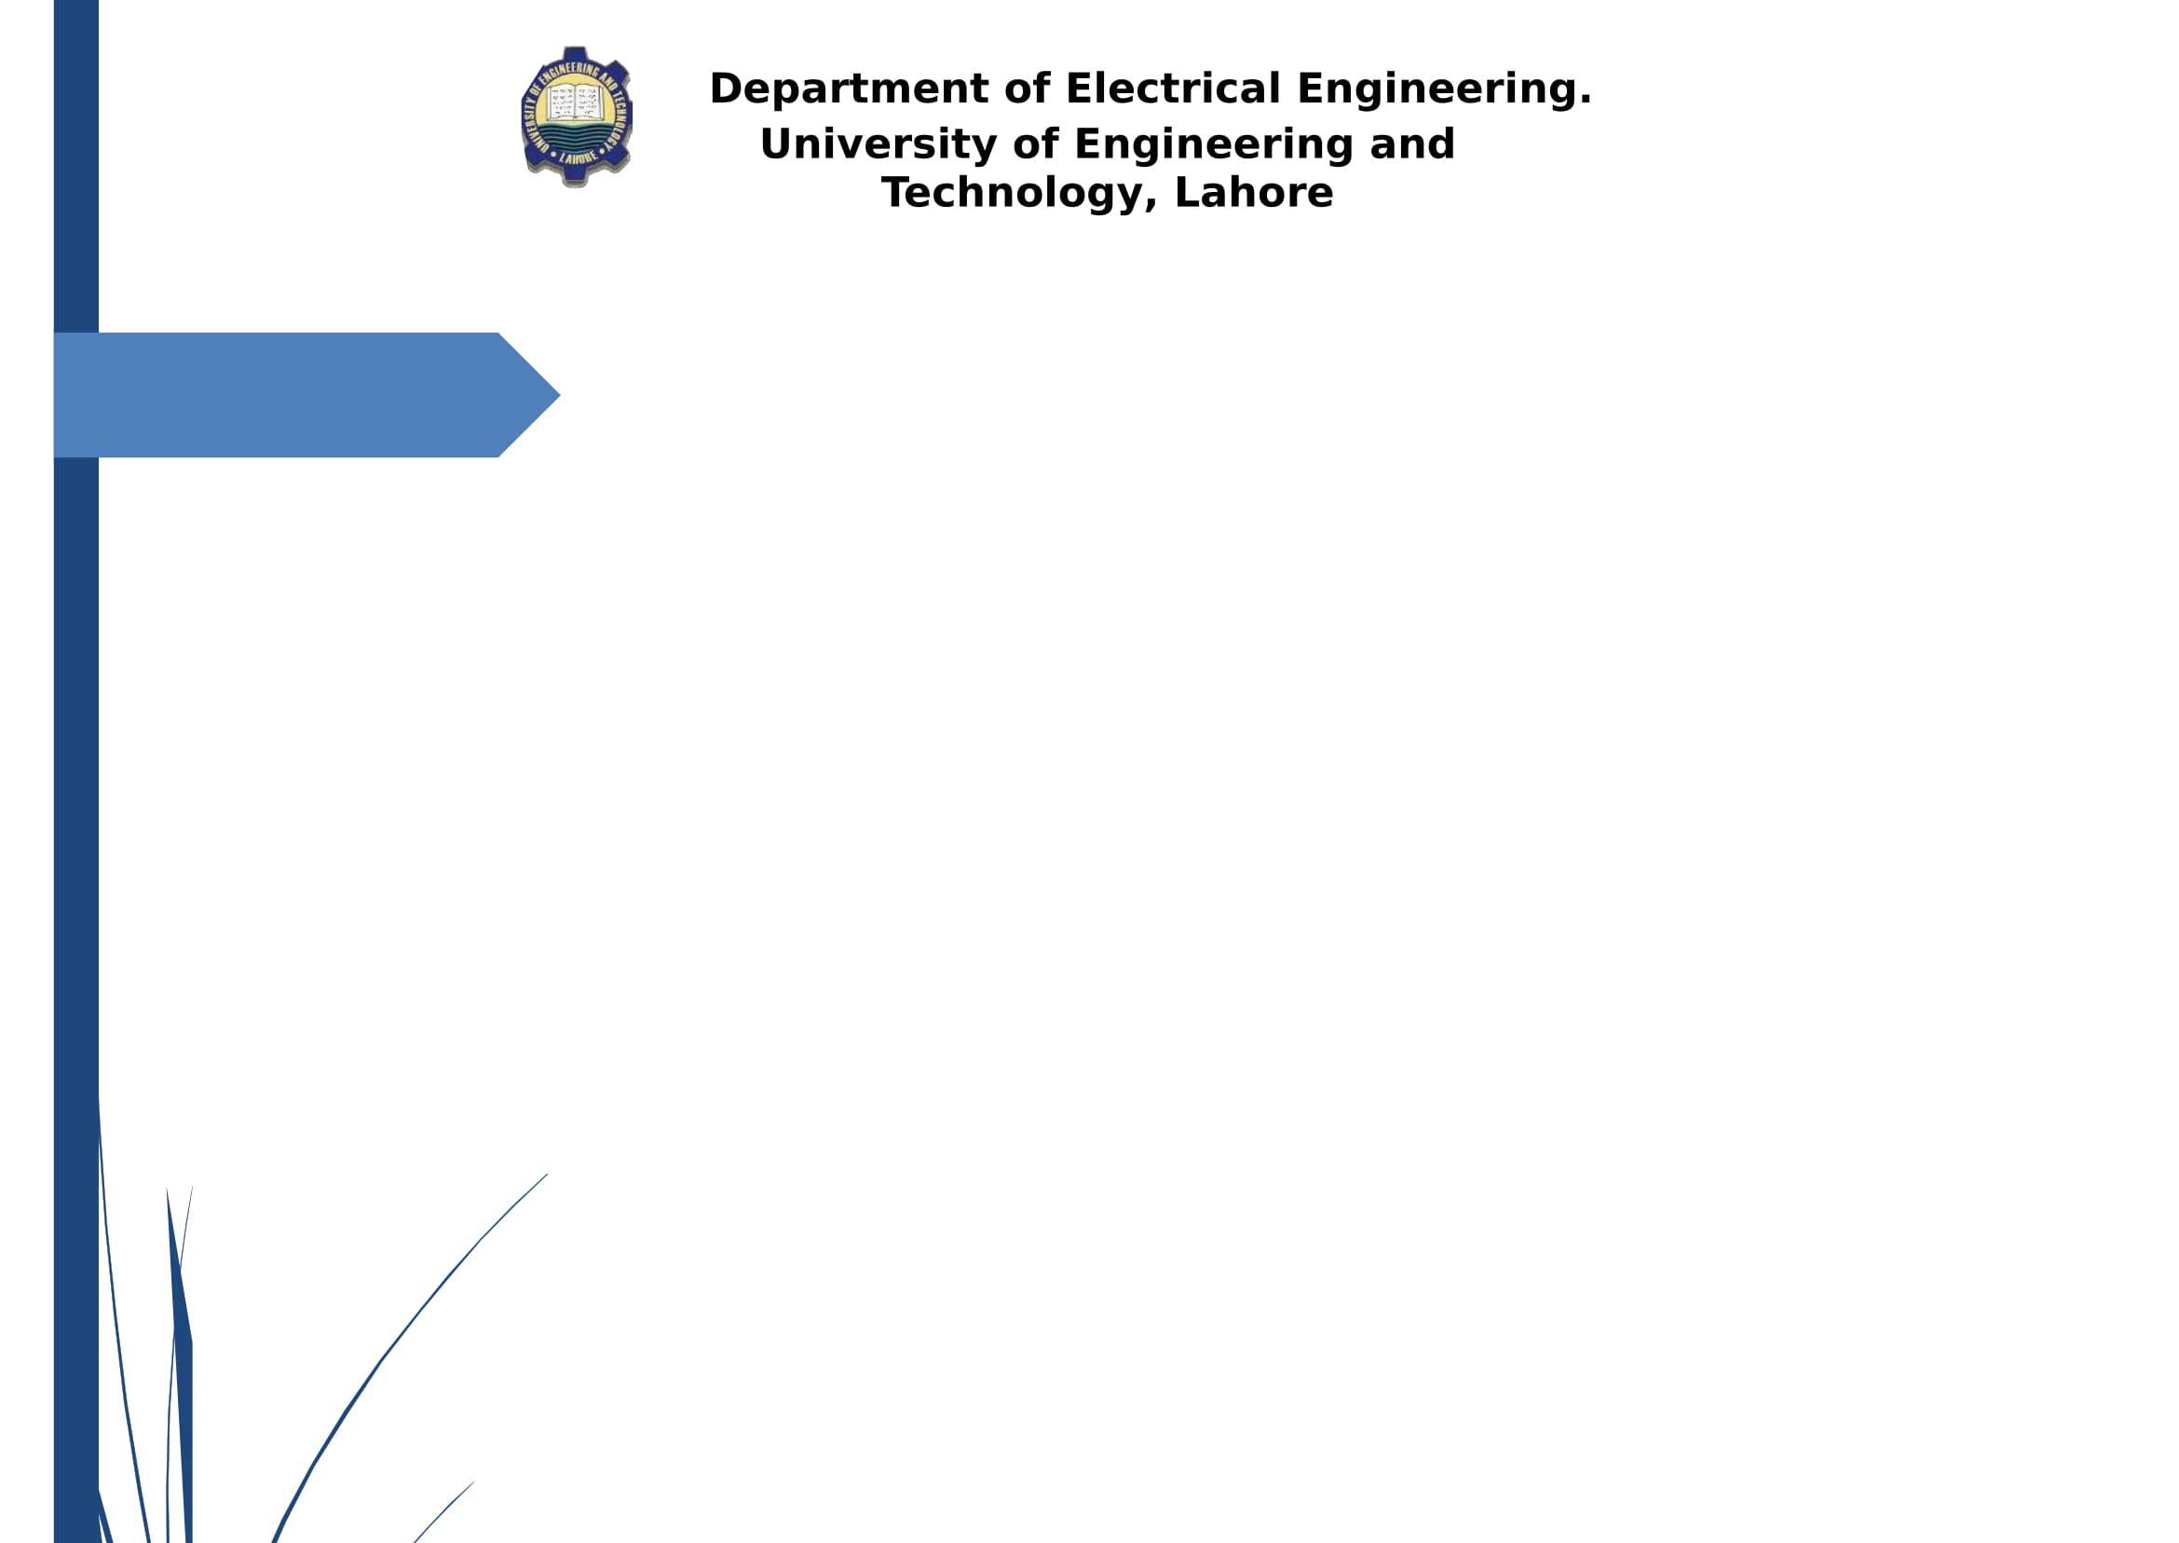


GeneBird Design & Development of Micro Swarm Drones
GeneBird
Project Advisor: Dr. Muhammad Kamran
Co-supervisor: Mr. Fahad Ijaz
Department of Electrical Engineering,
University of Engineering and Technology, Lahore (New Campus)
Undergraduate Final Year Project Presentation
Dated: 4th January, 2021

Slide 2
Team Introduction
Khalid Waheed
2017-EE-281
Specialization:
Major: Computer, Minor: Power
Noor ul Haq
2017-EE-298
Specialization:
Major: Computer, Minor: Power
Salman Hamid
2017-EE-325
Specialization:
Major: Computer, Minor: Power
Fahad Mehmood
2017-EE-330
Specialization:
Major: Power, Minor: Computer
Undergraduate Final Year Project Presentation
Dated: 4th January, 2021

Slide 3
Problem Statement
Pushing Drone technology to new heights and conducting research on this technology is way too much expensive.
The study of feedback control systems and the application of various machine learning algorithms and image recognitions algorithms, is often considered to be tough to be understood from the student’s perspective without any practical demonstration.
Undergraduate Final Year Project Presentation
Dated: 4th January, 2021

Slide 4
Problem Statement
Imagine there’s an operation going on in a hospital and the patient is in severe need of blood or an organ, but due to the non-timely delivery, the patient dies.
In times of crisis Rescue teams need to face huge calamities.
Heavy traffic results in a late delivery. Which results in less efficiency and poor productivity of the companies, due to all of the time wasted.
Undergraduate Final Year Project Presentation
Dated: 4th January, 2021

Slide 5
Problem Statement
The inspection of radioactive or hazardous areas also possess an extreme threat to the human life.
Security - Patrolling huge infrastructures and responding to any intrusion or anomaly is very cumbersome.
The use of guns, shotguns, and helicopters to transport the army squadron from one place to another requires a lot of vigilance and uses up a lot of resources, as well as keeping the lives of all the soldiers at risk.
Undergraduate Final Year Project Presentation
Dated: 4th January, 2021

Slide 6
Proposed Solution
GeneBird is aimed at meeting the criteria for new ML-based algorithms. Being a low cost, small and agile flight controller.
The aim of GeneBird is to push the boundary of what can thus be accomplished with autonomous flight.
GeneBird plays an intriguing role in STEM education. And can be used to teach feedback control systems and implications of various machine learning algorithms.
Undergraduate Final Year Project Presentation
Dated: 4th January, 2021

Slide 7
Proposed Solution
The delay in the delivery of the packages can be reduced by building a system based on GeneBird.
The use of GeneBird can not only increases the efficiency but also the productivity of the company, creating less pollution.
Frameworks based on GeneBird can play a vital role in search and rescue operations.
Undergraduate Final Year Project Presentation
Dated: 4th January, 2021

Slide 8
Proposed Solution
Humans are not going to be the first responders anymore. GeneBird based infrastructures can be developed to be the first responders in crisis management.
GeneBird based frameworks can also play a vital role in surveillance and security of large infrastructures.
GeneBird based swarm drones without doubt dawns a new age of modern warfare i-e the IoBT applications.
Undergraduate Final Year Project Presentation
Dated: 4th January, 2021

Slide 9
Proposed Solution
GeneBird based frameworks may also be used in solving the following problems:
Surveillance of Hazardous areas
Radiation mapping
Geological mapping
Topological mapping
Pipeline Monitoring
Undergraduate Final Year Project Presentation
Dated: 4th January, 2021

Slide 10
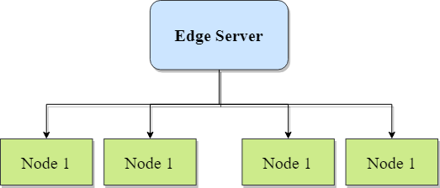
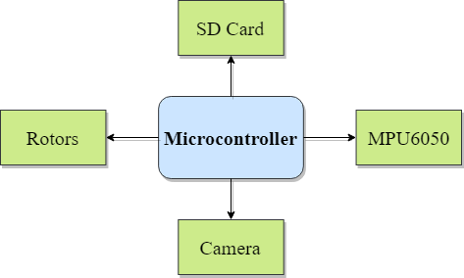
Block Diagram

Slide 11
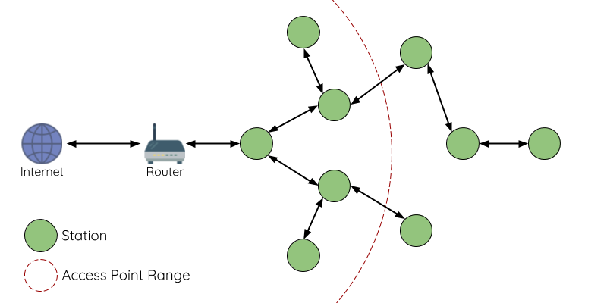

Block Diagram (Painless Mesh Network)
Mesh Node
Access Point Range

Slide 12
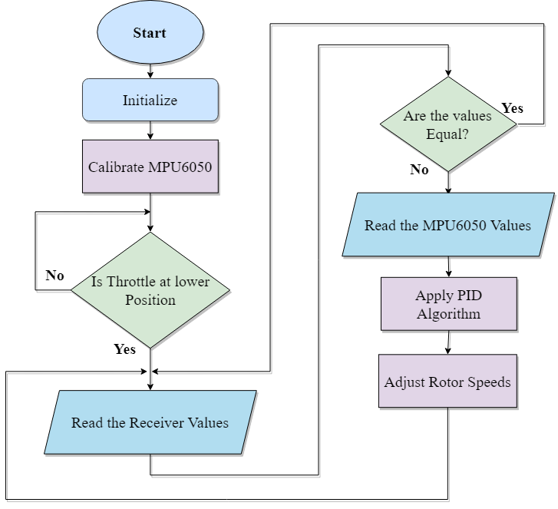
Flow Diagram (Drone)

Slide 13
Applications
Providing a more stimulant and attractive approach applied in STEM education by providing inspiring and captivating practical demonstrations of the different machine learning algorithms, computer vision and different control system’s concepts.
GeneBird will provide a cost effective frame work for the testing and upscaling of the products developed by the companies as well as the research institutes.
Undergraduate Final Year Project Presentation
Dated: : 4th January, 2021

Slide 14
Applications
Smart Delivery Drones
Police Drones
Smart Rescue Drone
STEM Education Drones
Mapping Drones
Undergraduate Final Year Project Presentation
Dated: : 4th January, 2021

Slide 15
Audience
Educational and research institutions, as well as industries and hobbyists who want to test their upcoming products on the more cost-effective architecture thus developed.
GeneBird is to play a vital role in universities; introducing students to the various concepts of machine learning and control systems as well as in colleges introducing the students to STEM education.
Undergraduate Final Year Project Presentation
Dated: : 4th January, 2021

Slide 16
What we have done so far?
Designed and Developed Flight controller on TIVA, Arduino/Atmega and ESP based Architectures.
Implementation of PID algorithm for onboard stabilization of drone.
Implemented OTA support on ESP8266 based micro drone.
Undergraduate Final Year Project Presentation
Dated: : 4th January, 2021

Slide 17
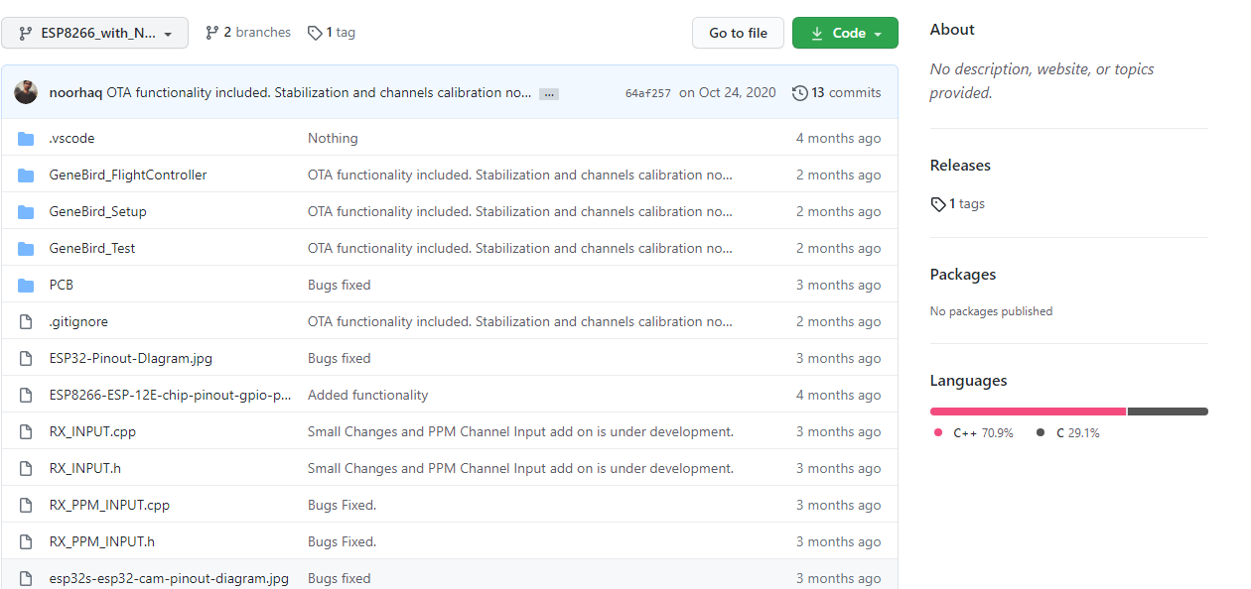
What we have done so far?
Made Github Repository for code updates and commits.
Undergraduate Final Year Project Presentation
Dated: : 4th January, 2021

Slide 18
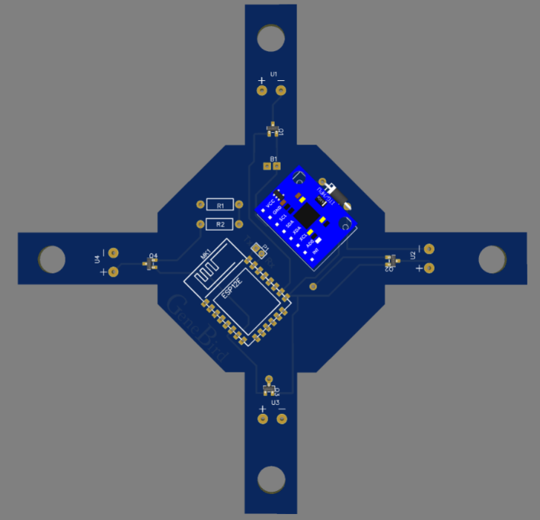
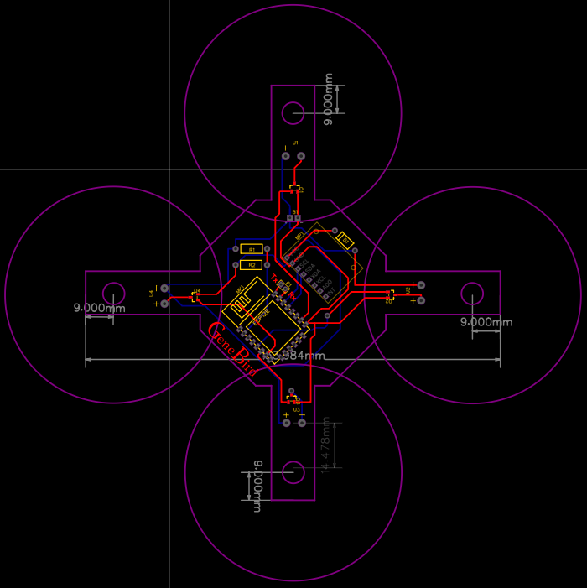
What we have done so far?
Designed PCB and Flight controller for ESP8266 based micro drone.
3D Model
Circuit Design
Undergraduate Final Year Project Presentation
Dated: : 4th January, 2021

Slide 19
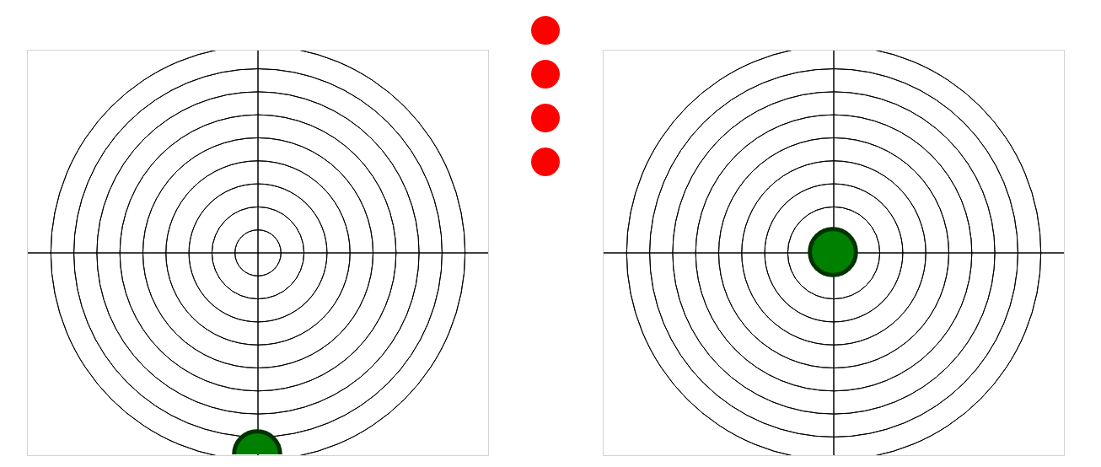
What we have done so far?
Designed HTML web page to control ESP based micro drone via IP.
Control Buttons
Throttle
Pitch
Yaw
Roll
Undergraduate Final Year Project Presentation
Dated: : 4th January, 2021

Slide 20
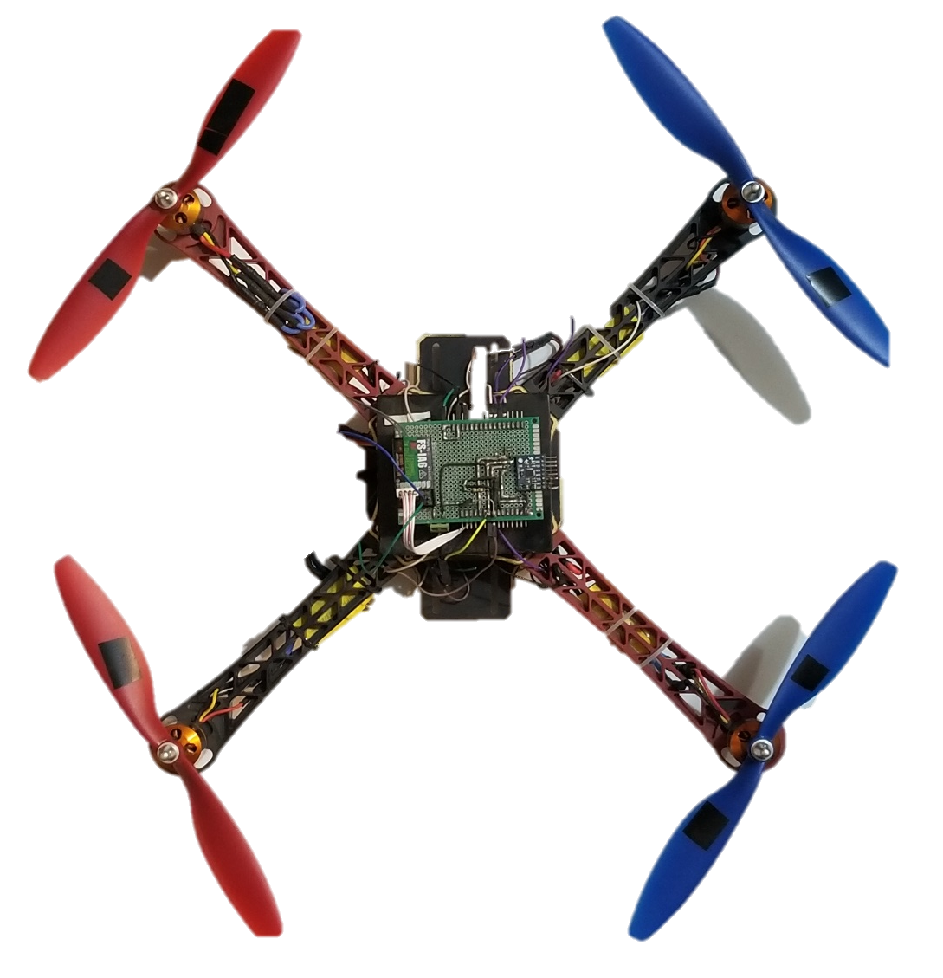
Hardware Developed
Developed drone based on TIVA and Arduino/Atmega Architecture.

Slide 21
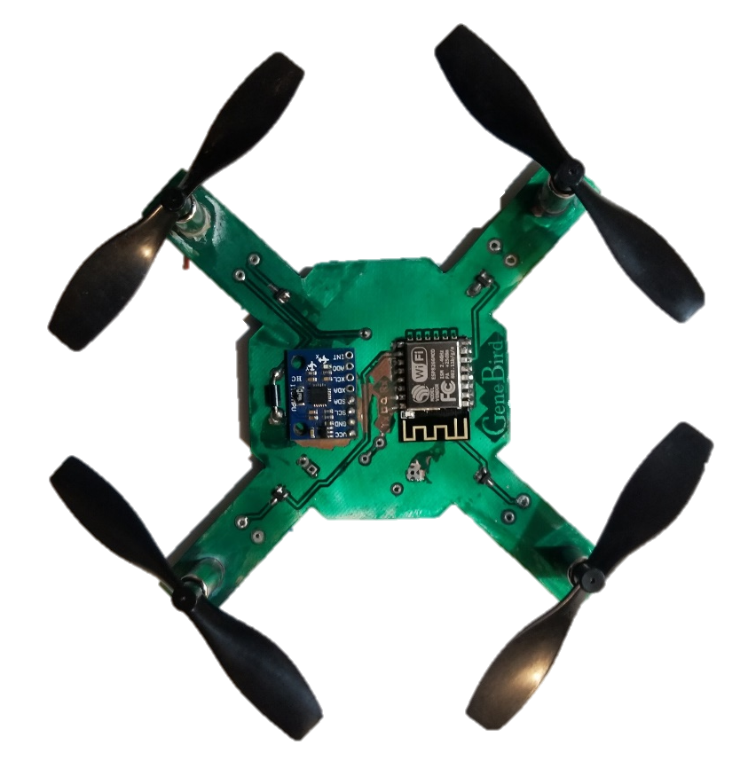
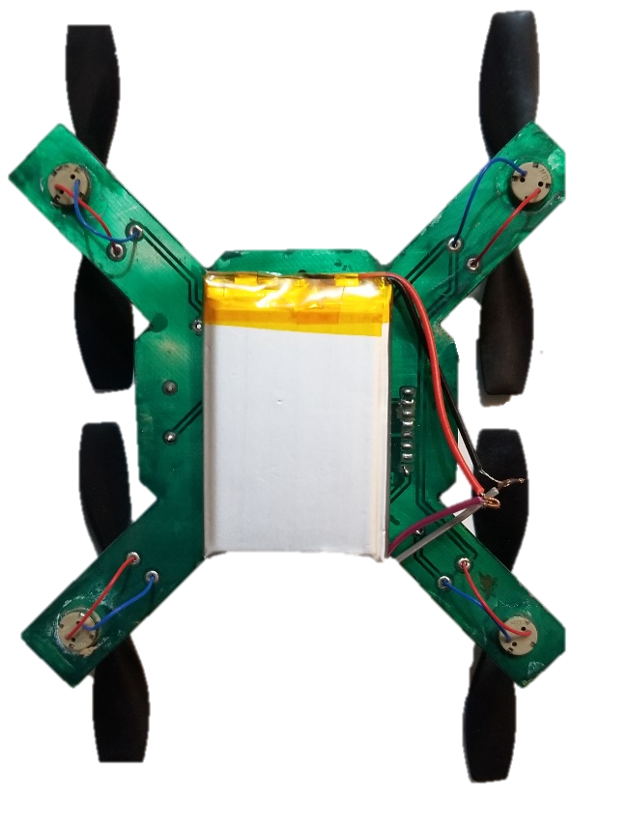
Hardware Developed
Developed ESP8266 Architecture based micro drone.
Undergraduate Final Year Project Presentation
Dated: : 4th January, 2021

Slide 22
Future Deliverables
A swarm of 4 drones, centrally controlled from an edge server, which would have the capability of projecting live video stream from the on-board mounted camera of the controller to the server.
Undergraduate Final Year Project Presentation
Dated: : 4th January, 2021

Slide 23
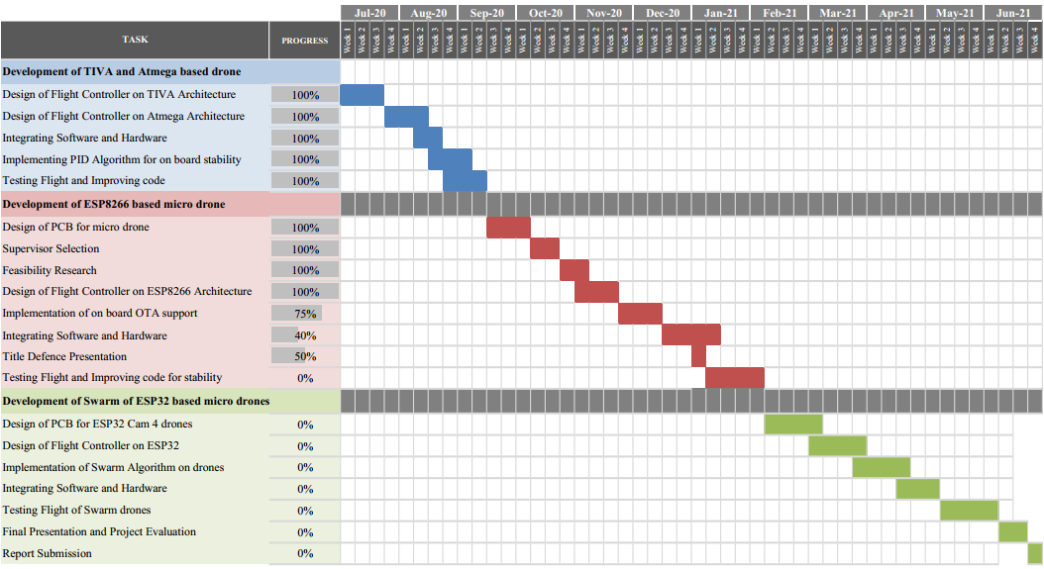
Gantt Chart

Slide 24
Comments
Undergraduate Final Year Project Presentation
Dated: : 4th January, 2021

